Slide 1

Fashion-MNIST Image Classification using ANN and CNN – Code, Results, and Innovation
A Project in Neural Systems and Natural Language Processing
Student: Achyut Savalia
Supervisor: Dr. Zacharias Anastassi
Course: Neural Systems and Natural Language Processing, DMU

Slide 2
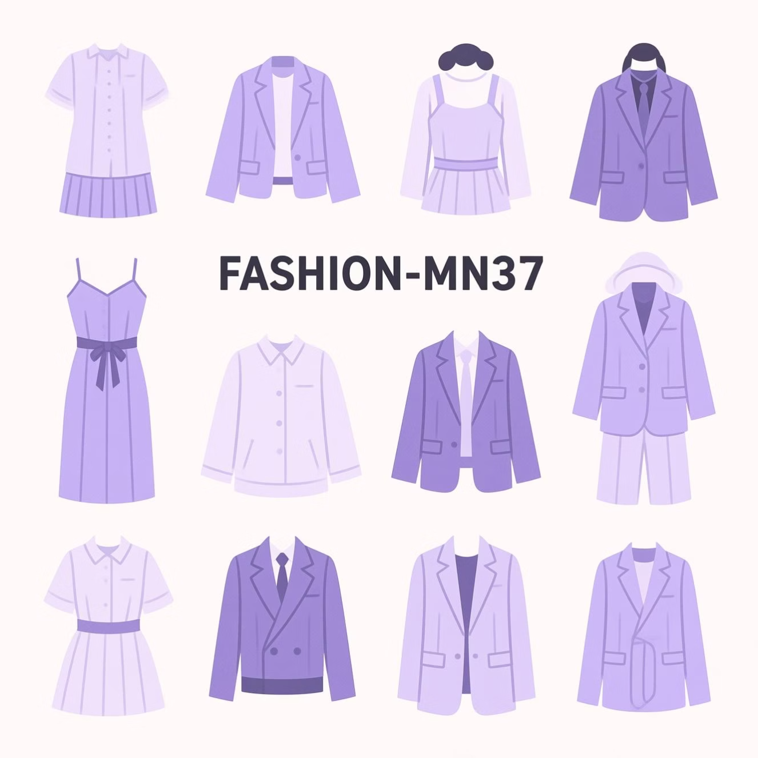
Introduction: Classifying Fashion with Neural Networks
This project compares the performance of two fundamental deep learning architectures—Artificial Neural Networks (ANN) and Convolutional Neural Networks (CNN)—for image classification.
We utilise the Fashion-MNIST dataset, which serves as a standard benchmark for computer vision tasks.
What is Fashion-MNIST?
It is a dataset comprising 70,000 grayscale images of 10 different clothing categories (e.g., shirts, trousers, bags).
Each image is a low-resolution 28x28 pixel representation.
Image classification is vital for real-world AI applications like automated inventory management and e-commerce recommendations.

Slide 3



Project Objectives and Scope
The core objective was to systematically build, train, and evaluate both ANN and CNN models on the same Fashion-MNIST dataset using the PyTorch framework.
Model Implementation
Performance Evaluation
Code Innovation
To construct and train both the ANN and CNN architectures from scratch in PyTorch.
To quantitatively compare the models based on key metrics like accuracy, convergence speed, and learning capability.
To implement and document innovative coding practices, such as custom validation splits and visual analysis tools.

Slide 4

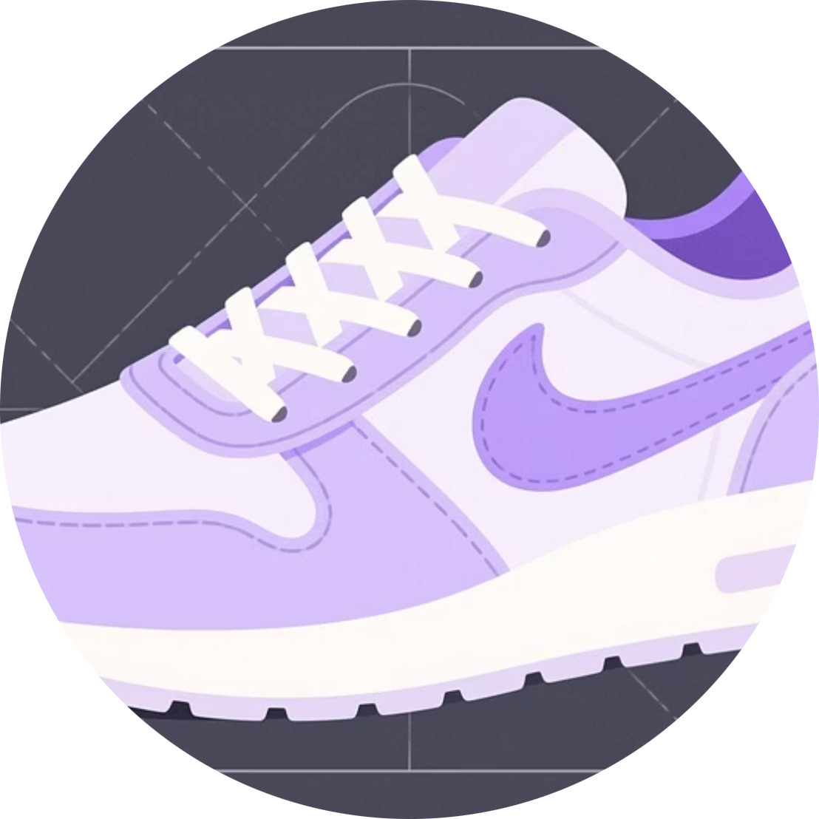

Dataset Structure and Preprocessing Pipeline
Dataset Size
Data Split
Preprocessing
70,000 total 28x28 grayscale images across 10 classes.
60,000 for Training, 12,000 for Validation, and 10,000 for Testing.
Pixel values normalised to the range [0, 1] using PyTorch transforms.
The 10 distinct clothing classes include T-shirt, Trouser, Pullover, Dress, Coat, Sandal, Shirt, Sneaker, Bag, and Ankle Boot.

Slide 5


Code Deep Dive: Data Loading and Innovation
PyTorch Data Preparation
Example code snippet for data transformation:
The torchvision.datasets.FashionMNIST class was utilised for efficient data handling.
transform = transforms.Compose([ transforms.ToTensor(), transforms.Normalize((0.5,), (0.5,))])
transforms.ToTensor() and transforms.Normalize() ensured the images were correctly formatted.
A DataLoader with a batch_size=64 and shuffle=True was used for iterative and randomised data feeding.
Innovation: Manual validation split (12,000 samples) was implemented from the standard training set for dedicated hyperparameter fine-tuning and better generalisation performance.

Slide 6

Model Architectures: ANN vs. CNN
Artificial Neural Network (ANN)
Convolutional Neural Network (CNN)
The 28x28 image was flattened into a 784-dimension vector. This was followed by multiple fully connected (Dense) layers with ReLU activation functions.
Utilised specialised layers (Convolution, Pooling) to automatically extract hierarchical features before passing to fully connected layers.
Weakness: Ignores spatial relationships between pixels.
Strength: Excellent at capturing local features like edges and textures.
Shared Parameters: Adam Optimizer (Learning Rate: 0.001), CrossEntropyLoss, 10 Epochs, Batch Size: 64. Models were run on both CPU and GPU where available.

Slide 7
Innovation and Reproducibility
Beyond training the base models, several innovative coding methods were incorporated to ensure robust analysis and clear documentation.
Custom Validation Split
Visual Analysis Tools
Reproducibility Focus
Introduced a non-standard 12,000 image validation set to accurately tune hyperparameters and prevent test set leakage.
Developed matplotlib scripts to dynamically visualise accuracy and loss curves for both training and validation sets.
Every step, from data loading to model evaluation, was clearly documented with comments and designed for easy re-execution.
Future suggestions include implementing learning rate scheduling and data augmentation to push accuracy further.

Slide 8




Training and Evaluation Protocol
The training process involved standard deep learning loops, ensuring rigorous measurement of performance at every step.
Forward Pass
Loss Calculation
Input images pass through the network to generate predictions (logits).
Cross-entropy loss computed between predictions and true labels.
Backward Propagation
Optimizer Step
Gradients computed and propagated backward through the layers.
Model weights updated using the Adam optimizer to minimise loss.
The torch.no_grad() context manager was used during validation and testing to disable gradient calculation, saving memory and speeding up evaluation.
Progress logs tracked loss and accuracy improvements across the 10 epochs.

Slide 9
Output and Key Results Summary
The evaluation on the 10,000-image test set revealed a clear performance gap, validating the architectural advantages of the CNN.
88.44%
92.11%
ANN Test Accuracy
CNN Test Accuracy
The fully connected network achieved a respectable baseline, but struggled with detailed feature recognition.
The CNN model demonstrated superior accuracy, indicating its effectiveness in extracting spatial hierarchies.
Key Insight:
CNN exhibited faster convergence during training. Both models demonstrated confusion, particularly between semantically similar classes like "Shirt" and "Coat".

Slide 10
Model Comparison: A Quantitative Overview
A detailed comparison highlights the practical differences between the two architectures in the context of image classification.
Feature
ANN (Artificial Neural Network)
CNN (Convolutional Neural Network)
Test Accuracy
88.44%
92.11%
Feature Extraction
Weak (Pixel-based)
Strong (Hierarchical)
Training Speed
Medium
Fast (Especially with GPU)
Overfitting Tendency
Slight
Minimal
Visual Understanding
Low
High
The CNN's ability to reuse weights (via convolution) and reduce dimensionality (via pooling) makes it inherently superior for image data.

